Slide 1

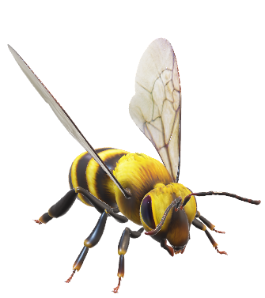
Safest Solutions in Bloom

